Slide 1
First LAST
1
2
3
4
-1
-2
-3
-4
1 2 3 4
-1 -2 -3 -4

Slide 2
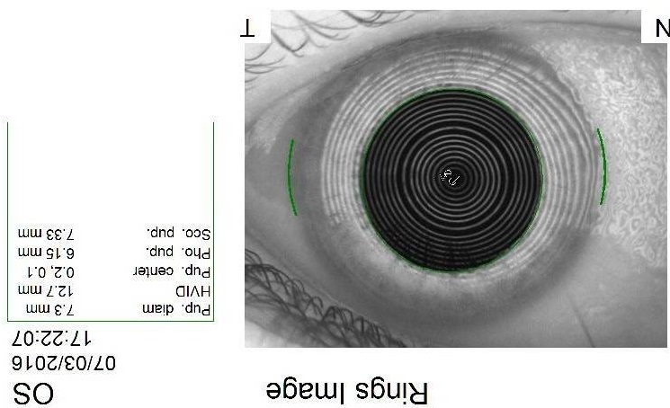
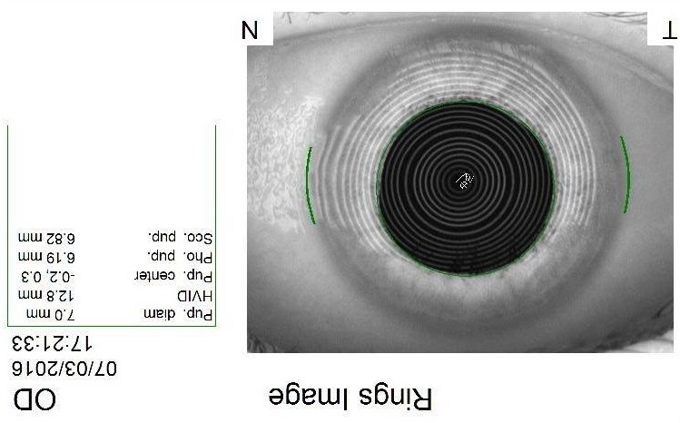
First LAST
+1
+2
+3
+4
-1
-2
-3
-4
+1 +2 +3 +4
-1 -2 -3 -4

